Slide 1
Methods & Statistics in IO Psychology
Chapter 2

Slide 2
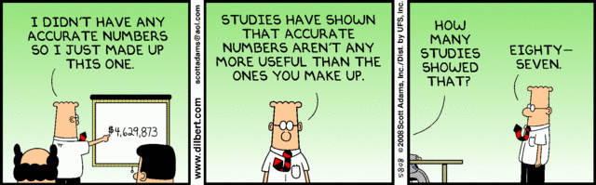
Overview
Module 2.1 – Science and Research
Module 2.2 – Data Analysis
Module 2.3 – Interpretation

Slide 3
Module 2.1 – Science & Research

Slide 4
What is Science?
Approach that involves the _____________, _____________, and _____________ of some phenomenon of interest
A set of methods used to
Collect information about phenomena in an area
Build a reliable base of information in an area
Develop theories to explain phenomena

Slide 5
Overview of Research in IO
Three purposes…
Description
Explanation
Prediction
…all rooted in Theory…
…confirmed and built upon by Data

Slide 6
Overview of Research in IO
The cycle of research
Theory
Data

Slide 7
The Scientific Method: Four Steps
Observing a Phenomenon
While observing a phenomenon, you identify the _____________ that appear important in explaining behavior
Formulating Tentative Explanations
Initial observations allow you to develop a ______________, or tentative statement, about the relationships among the variables identified

Slide 8
The Scientific Method: Four Steps
Further Observing and Experimenting
You carry out more detailed ________________ of the behavior of interest
Refining and Retesting Explanations
Supported hypotheses are often ___________ and subjected to further exploration
Disconfirmed hypotheses may be reworked and _____________

Slide 9
Characteristics of Scientific Explanations
Scientific explanations are EMPIRICAL – They are based on objective, systematic observations
Scientific explanations are RATIONAL – They follow the rules of logic and are consistent with known facts
Scientific explanations are TESTABLE – They are verifiable through observation and can be disproved
Scientific explanations are PARSIMONIOUS – They provide the simplest explanation using the fewest possible assumptions
Scientific explanations are GENERAL – They apply beyond the original observations on which they are based
Scientific explanations are TENTATIVE – They are never accepted as absolutely correct
Scientific explanations are RIGOROUSLY EVALUATED – They are constantly evaluated for consistency with evidence, generality, and parsimony
Extra Information

Slide 10
The Research Process
The cycle of research
Define Question
Develop Theory
Hypothesize
Collect Data
Publish Results
Interpret Data
Analyze Data

Slide 11
Research Design
__________________________
Random assignment of participants to conditions
Between-subjects, within-subjects, or single subject designs
Can be conducted in lab or field setting
__________________________
Nonrandom assignment of participants to conditions
Quasi-independent variable (e.g., gender)
Can be conducted in lab or field setting

Slide 12
Research Design Continued
__________________________
No unique conditions for participants
Observational or correlational designs
Generally conducted in the field

Slide 13
Research Design Continued
 | Laboratory Experiment | Quasi-Experiment | Questionnaire | Observation
Control (potential for testing causal relationships) | High | Moderate | Low | Low
Realism (naturalness of setting) | Low | High | Moderate | High

Slide 14
Methods of Data Collection
Quantitative
Rely on tests, rating scales, questionnaires, and physiological measures
Yield numerical results
Qualitative
Include procedures like observation, interview, case study, & analysis of written documents
Generally produce flow diagrams & narrative descriptions of events/processes
Can be converted to numerical results

Slide 15
Methods of Data Collection Continued
Quantitative vs. Qualitative – not mutually exclusive
Triangulation…
Data provided from multiple sources
Use of quantitative and qualitative data

Slide 16
Generalizability & Control
____________ – apply results from one study/sample to other participants or situations
Called external validity
Every time a compromise is made, the generalizability of results is reduced
Population: the entire set of people or objects we want to study and to which we wish to generalize the findings
Sample: subgroup of the population that is used to infer about the characteristics of the population

Slide 17
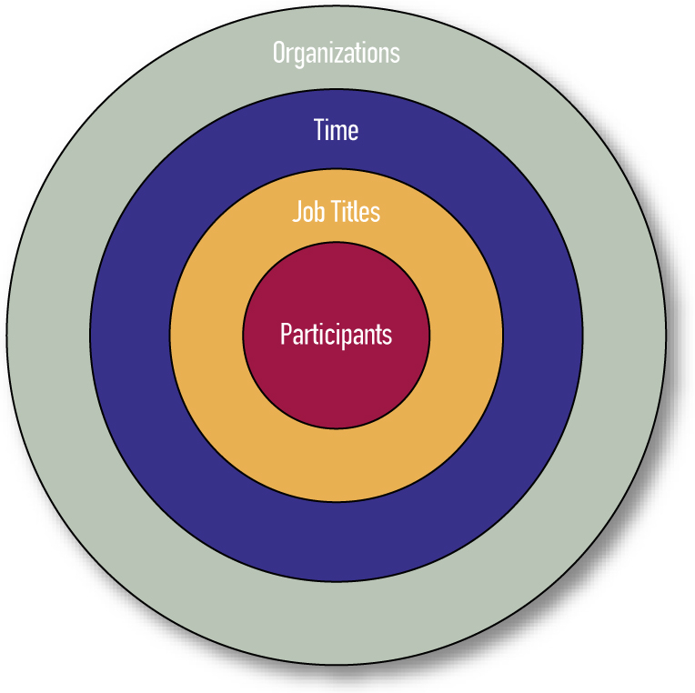
Sampling Domains for I-O Research
Figure 2.1: Sampling Domains
for I-O Research

Slide 18
Generalizability & Control
_______________________: research design eliminates influences that could make results less reliable or harder to interpret
_______________________: statistical techniques used to control for the influence of certain variables
Experimental control trumps statistical control

Slide 19
Ethical Behavior in I-O Psychology
Ethical standards of the APA
SIOP book of 61 cases (Lowman, 1998)
Cases illustrate ethical issues that are likely to arise in I-O psychology
Joel Lefkowitz (2003) published a book on values and ethics in I-O psychology

Slide 20
Module 2.2 – Data Analysis

Slide 21
Data Analysis
____________________: summarize, organize, “describe” sample of data
Frequency Distribution:
Horizontal axis = Scores running low to high
Vertical axis = Indicates frequency of occurrence
Measures of central tendency
Variability
Skew

Slide 22
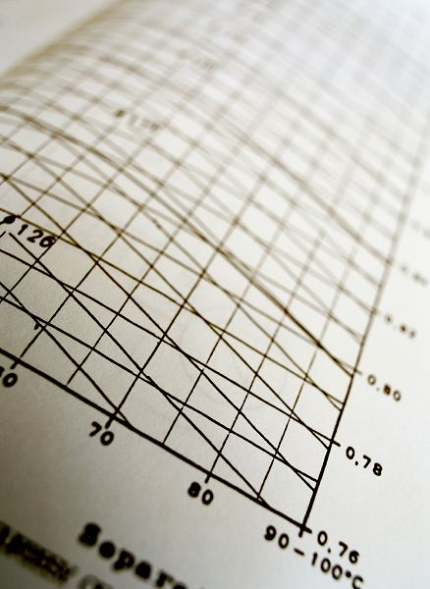
Measures of Central Tendency
Mode (most common score)
1 2 6 6 7 9 11
Mean (the average)
1 2 3 4 5 6
1 2 3 4 5 2000
Median (the midpoint)
1 2 4 6 7 9 11
1 2 6 7 9 11
1 2 3 4 5 2000
Ryan McVay/Getty Images

Slide 23
Measures of Variability & Skew
Standard deviation
Describes the dispersion of data on either side of a mean value
The typical amount that each score varies, or “deviates”, from the mean
Lopsidedness or skew

Slide 24
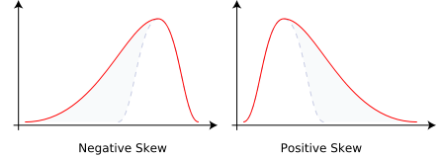
Skewness

Slide 25
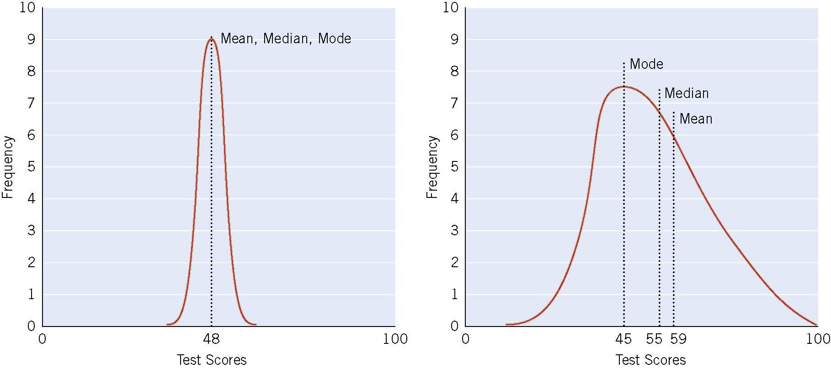
Two Score Distributions (N = 30)
Figure 2.2 Two Score Distribution (N=30)

Slide 26
Inferential Statistics
Aid in testing hypotheses & making inferences from sample data to a larger sample/population
Examples include t-test, F-test, chi-square test

Slide 27
Statistical Significance & Power
Statistical Significance
Statistical Power
Defined in terms of a probability statement
Threshold for significance is often set at .05 or lower
Finding significant at the 5% level
i.e., a difference that large would be expected to occur only 5 times out of 100 as a result of chance alone
Likelihood of finding statistically significant difference when true difference exists
Smaller sample size → lower power

Slide 28
Pearson’s Product-Moment Correlation Coefficient
Abbreviated r (sample) or ρ (population)
Index of linear relationship between variables
Ranges from -1 to +1
Sign indicates direction of relationship
Number indicates magnitude of relationship
Related to the coefficient of determination, r²

Slide 29
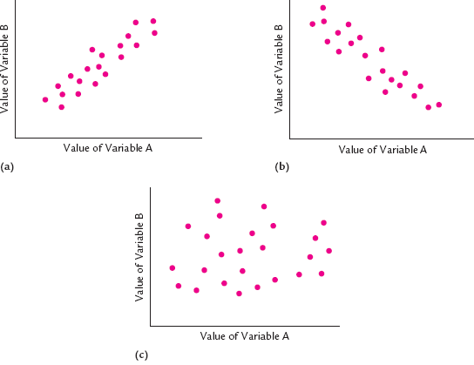
Correlation

Slide 30
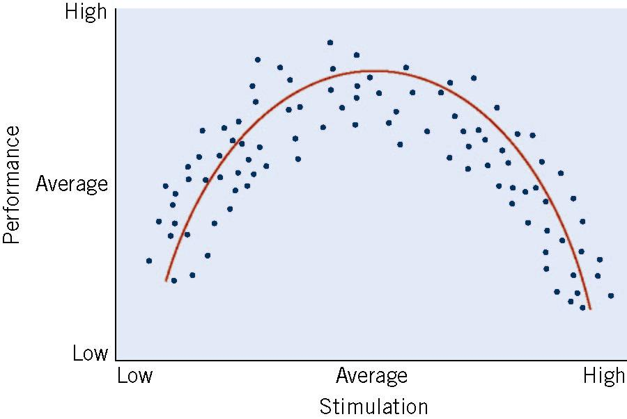
Curvilinear Correlation
Figure 2.7
An Example of
a Curvilinear
Relationship

Slide 31
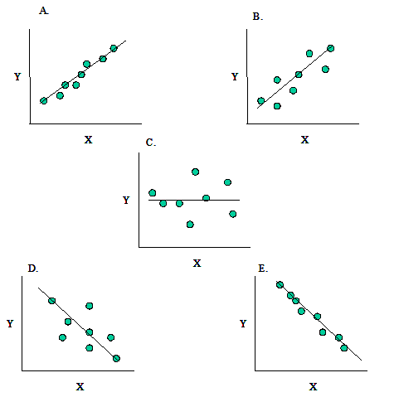
Regression
___________________
Line of “best fit”
Used for prediction of a criterion (DV) from a predictor (IV)
___________________
Allows for many predictors simultaneously
Multiple correlation coefficient, R

Slide 32
Meta-Analysis
Aggregation of multiple studies of the same underlying relationship
Example: Job Performance vs. Job Satisfaction
N of studies | N of people | Estimated ρ
312 | 54,471

Slide 33
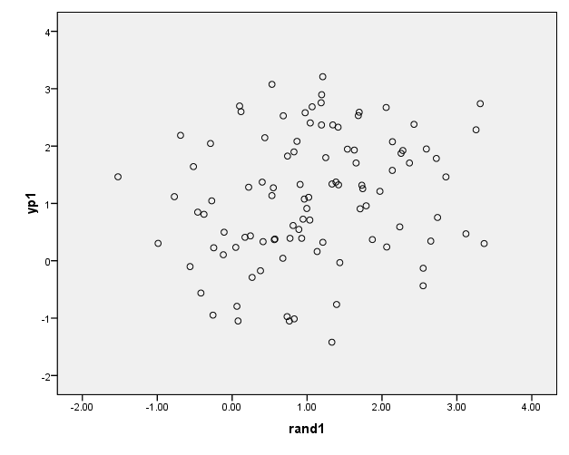
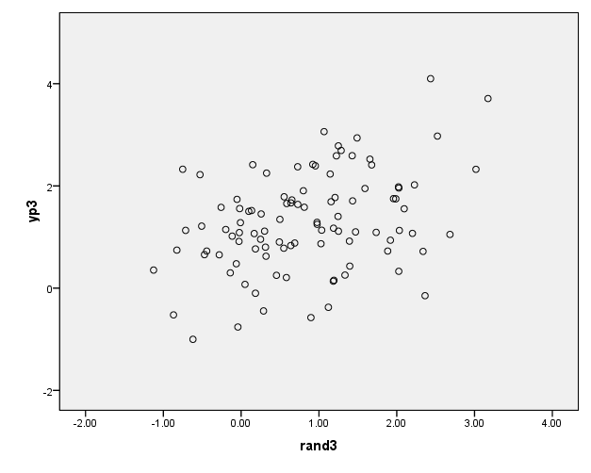
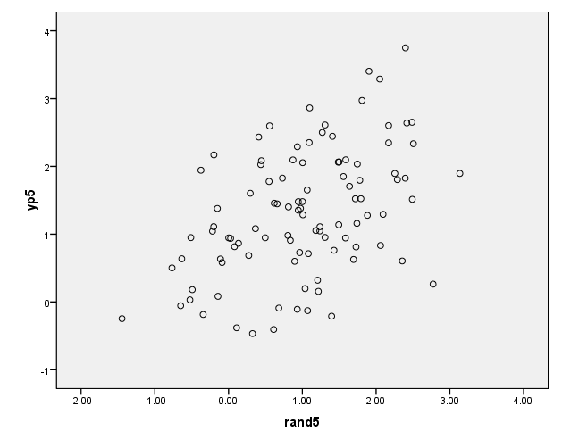
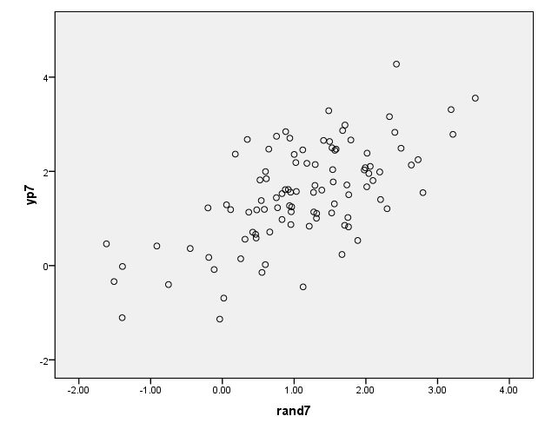
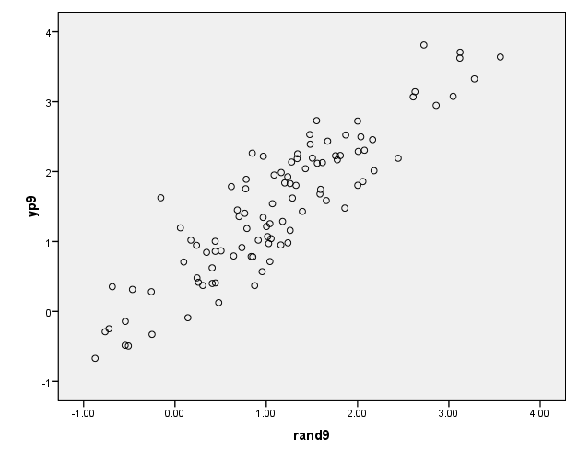
What is the relationship between Job Performance and Job Satisfaction?
r = 0.10
r = 0.30
r = 0.50
r = 0.70
r = 0.90

Slide 34
Module 2.3 – Interpretation

Slide 35
Reliability
The RELIABILITY of a Measure
A reliable measure produces similar results when repeated measurements are made under identical conditions
Reliability is necessary but not sufficient for validity
Should be > .70

Slide 36
Types of Reliability
______________________: Administer the same test twice
___________________________: Alternate forms of the same test used
______________________
Split-half reliability: Parallel forms are included on one test and later separated for comparison
Cronbach’s alpha: Average of all possible split-half reliabilities. Assesses how the items “hang together”
______________________: level of agreement among raters

Slide 37
Validity
Validity of a study is distinct from validity of a measure
Is a study internally and externally valid?
The VALIDITY of a Measure
A valid measure measures what you intend it to measure
Validity is a unitary construct
Employee Well-being
Construct
5-item scale
No. of smiles
Brain scan
Operationalization
Notes:
Key terms to define: construct; conceptual and operational level; predictor; criterion

Slide 38
Methods of Establishing Validity
__________________: How adequately does a test sample behavior it is intended to measure?
A measure has content validity if its items are relevant to construct being measured

Slide 39
Methods of Establishing Validity
__________________: Do the results of a test correlate with what is theoretically known about the construct being evaluated?
Convergent validity: does the measure correlate with other theoretically similar measures
Discriminant validity: does the measure NOT correlate with other measures it theoretically should NOT be related to

Slide 40
Methods of Establishing Validity
______________________: How adequately does a test score match some criterion score?
Indexed by a validity coefficient
Takes two forms
Concurrent validity:
Test and criterion measured at the same time
Do scores correlate?
Predictive validity:
Time lag between test and criterion measurement
Does test predict the criterion?

Slide 41
Reliability vs. Validity
A game of darts as metaphor for a test. The goal of darts is to hit the bullseye.
Not consistent or accurate
Consistent but not accurate
Consistent and accurate

Slide 42
Relationships Between Variables
Direct (Causation)
Mediation
Moderation

Slide 43
Relationships Between Variables
CAUSATION
Stress
JP

Slide 44
Relationships Between Variables
MEDIATION
Stress
Job Satisfaction
JP

Slide 45
Relationships Between Variables
MODERATION
Job Satisfaction
Stress
JP

